Slide 1

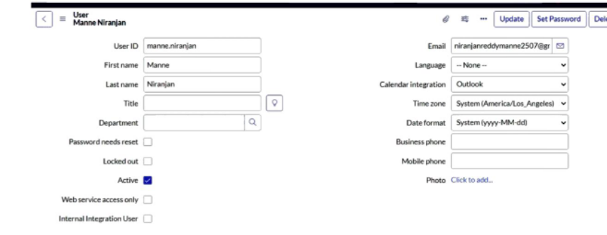
StreamliningTicket Assignment for Efficient Support Operations
TEAMID:NM2025TMID13343
TEAMLEADER:PRAGADEESHWARAN.M
TEAMMEMBER1:NARAYANASAMI.D
TEAMMEMBER2:HARIHARAN.R
TEAMMEMBER3:OMKUMAR.K
ACTIVITY1:USERS
CREATEUSER
Openservicenow.
ClickonAll >>searchfor users
Select Usersunder systemsecurity
Clickonnew
Fill thefollowingdetailstocreateanewuser
ClickSubmit

Slide 2
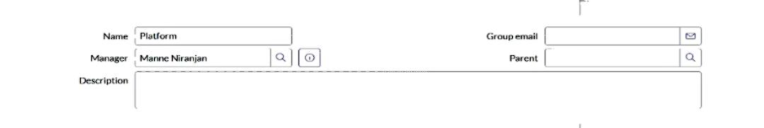
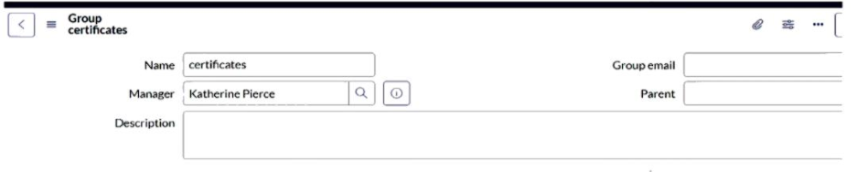
Activity 2: GROUPS
CREATE GROUPS
Openservicenow.
Click onAll >>searchfor groups
Select groupsunder systemsecurity
Click onnew
Fill thefollowingdetailstocreateanewgroup
Click Submit
Activity 3:ROLES
CREATEROLES
Openservicenow.
Click onAll >>searchfor roles
Select rolesunder systemsecurity
Click onnew
Fill thefollowingdetailstocreateanewrole
Click onsubmit.

Slide 3
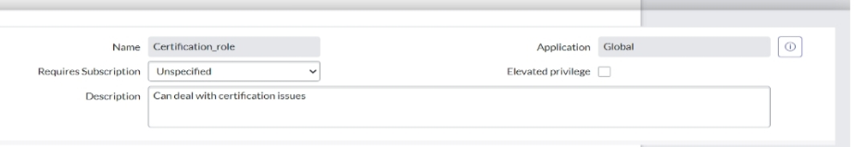
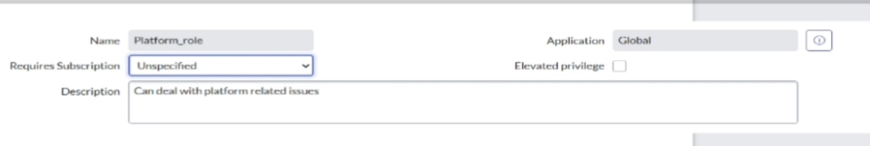
Activity 4: TABLES
CREATETABLE
Openservicenow.
ClickonAll >>searchfor tables
Select tablesunder systemdefinition
Clickonnew
Fill thefollowingdetailstocreateanewtable
Label :Operationsrelated
ChecktheboxesCreatemodule&Createmobilemodule
Under newmenuname:Operationsrelated
Under tablecolumnsgivethecolumns.
Clickonsubmit
Createchoicesfor theissuefiledby usingformdesign
Choicesare
Unabletologintoplatform
404error
Regardingcertificates
Regardinguser expired

Slide 4
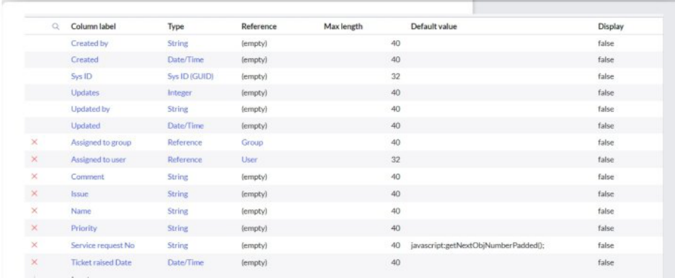
Activity 5:Assignroles& userstocertificategroup
Assignrolesandresponsibilities
Openservicenow.
Click onAll >>searchfor tables
Select tablesunder systemdefinition
Select thecertificatesgroup
Under groupmembers
Click onedit
Select KatherinePierceandsave
Click onroles
Select Certification_roleandsave
Assignrolesandplatformtocertificategroup
Openservicenow.
Click onAll >>searchfor tables
Select tablesunder systemdefinition
Select theplatformgroup

Slide 5
Under groupmembers
Click onedit
Select ManneNiranjanandsave
Click onroles
Select Platform_roleandsave
Activity 6: Assingroletotable
Openservicenow.
Click onAll >>searchfor tables
Select operationsrelatedtable
Click ontheApplicationAccess
Click onu_operations_relatedreadoperation
Click ontheprofileontopright side
Click onelevaterole
Click onsecurity adminandclick onupdate
Under Requiresrole
Doubleclick oninsert anewrow
Giveplatformrole
Andaddcertificaterole
Click onupdate

Slide 6
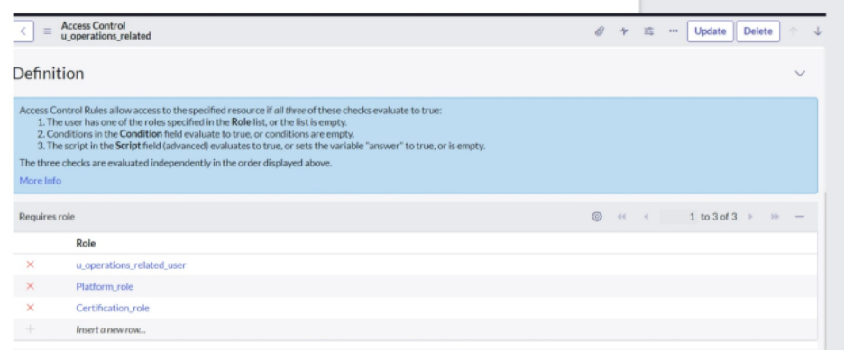
Click onu_operations_relatedwriteoperation
Under Requiresrole
Doubleclick oninsert anewrow
Giveplatformrole
Andaddcertificaterole
Activity 7:ACL
Createacl
Openservicenow.
Click onAll >>searchfor ACL
Select AccessControl(ACL)under systemsecurity
Click onnew
Fill thefollowingdetailstocreateanewACL.

Slide 7
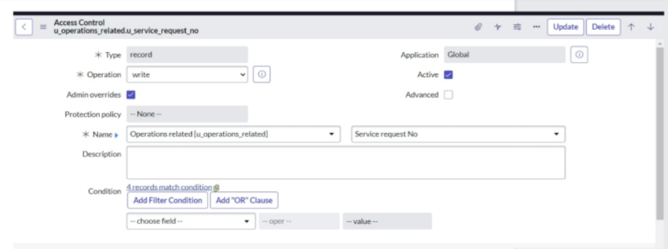
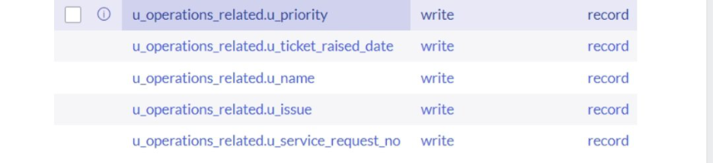
Scroll downunder requiresrole
Doubleclick oninsert anewrow
Giveadminrole
Click onsubmit
Similarly create4acl for thefollowingfields
Activity 8:Flow
CreateaFlowtoAssignoperationsticket to
Group
Openservicenow.
Click onAll >>searchfor FlowDesigner
Click onFlowDesigner under ProcessAutomation.

Slide 8
After openingFlowDesigner Click onnewandselect Flow.
Under FlowpropertiesGiveFlowNameas“ Regarding
Certificate”.
ApplicationshouldbeGlobal.
Select Runuser as“ Systemuser ” fromthat choice.
Click onSubmit.
Nowunder Actions.
Click onAddanaction.
Select actioninthat searchfor “ UpdateRecord”.
InRecordfielddragthefieldsfromthedatanavigationfromleft
side
Tablewill beautoassignedafter that
Givethefieldas“ Assignedtogroup”
Givevalueas“ Certificates”
Click onDone
Click onSavetosavetheFlow
Click onActivate
Activity 9:CreateaFlowtoAssignoperationsticket to
Platformgroup
Openservicenow.
Click onAll >>searchfor FlowDesigner
Click onFlowDesigner under ProcessAutomation.
After openingFlowDesigner Click onnewandselect Flow.

Slide 9
Under FlowpropertiesGiveFlowNameas“ RegardingPlatform
”
ApplicationshouldbeGlobal.
Select Runuser as“ Systemuser ” fromthat choice
Click onSubmit.
Click onAddatrigger
Select thetrigger inthat Searchfor “createor updatearecord”
andselect that.
Givethetablenameas“ Operationsrelated”
GivetheConditionas
Field:issue
Operator :is
Value:Unabletologintoplatform
Click onNewCriteria
Field:issue
Operator :is
Value:404Error
Click onNewCriterie
Field:issue
Operator :is
Value:RegradingUser expired
After that click onDone
Nowunder Actions.
Click onAddanaction.

Slide 10
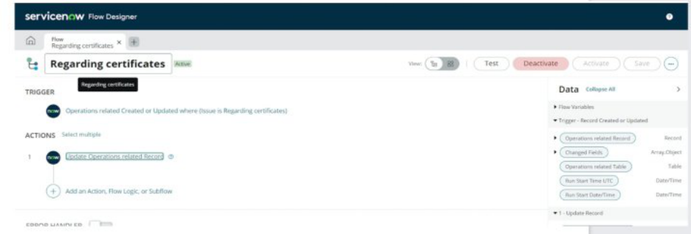
Select actioninthat searchfor “ UpdateRecord”.
InRecordfielddragthefieldsfromthedatanavigationfromleft
side
Tablewill beautoassignedafter that
Givethefieldas“ Assignedtogroup”.
Givevalueas“ Platform”.
Click onDone
Click onSavetosavetheFlow.
Click onActivate.
Conclusion:Theimplementationoftheautomatedticket routingsystem
at ABCCorporationhasbeenasignificant success.By leveragingthe
capabilitiesofServiceNow, wehavestreamlinedtheprocessofassigning
support ticketstotheappropriateteams, addressingthechallengesof
manual routing, andensuringtimely resolutionofissues.

